Slide 1

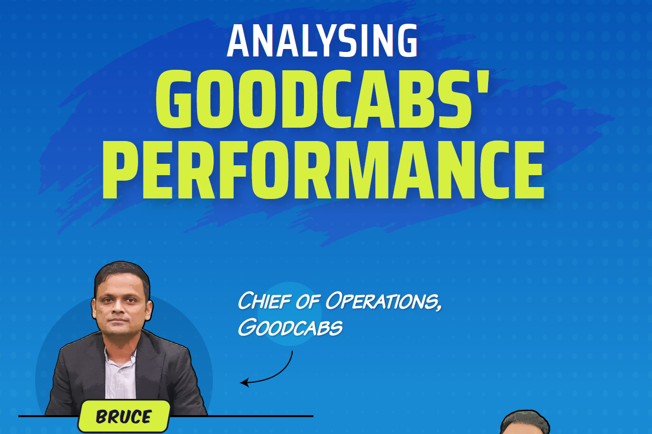

Slide 2
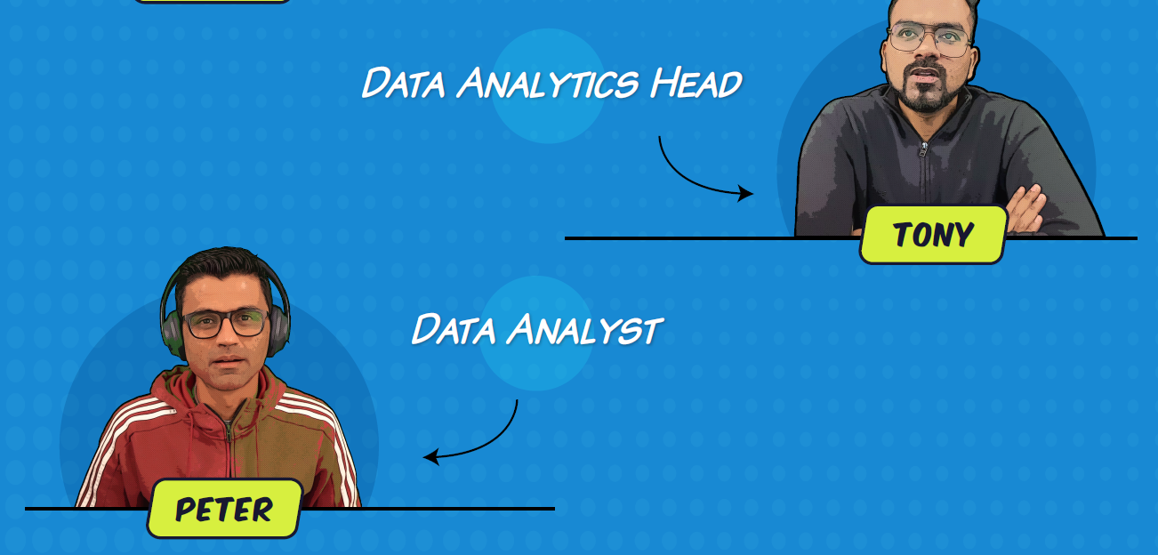

Slide 3
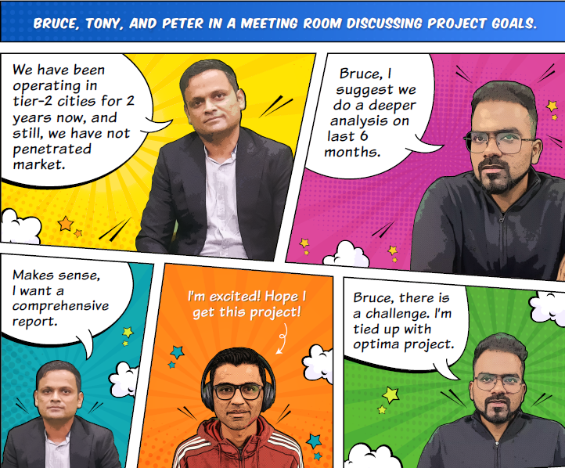

Slide 4


Slide 5


AS
Peter
Manoj Kumar M

Slide 6
JAIPUR
COIMBATORE
SURAT
VADODARA
CITIES
INDORE
KOCHI
CHANDIGARH
VISHAKAPATNAM
LUCKNOW
MYSORE

Slide 7
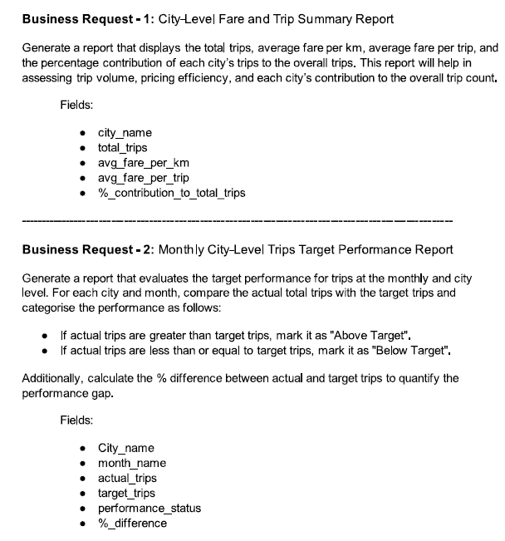
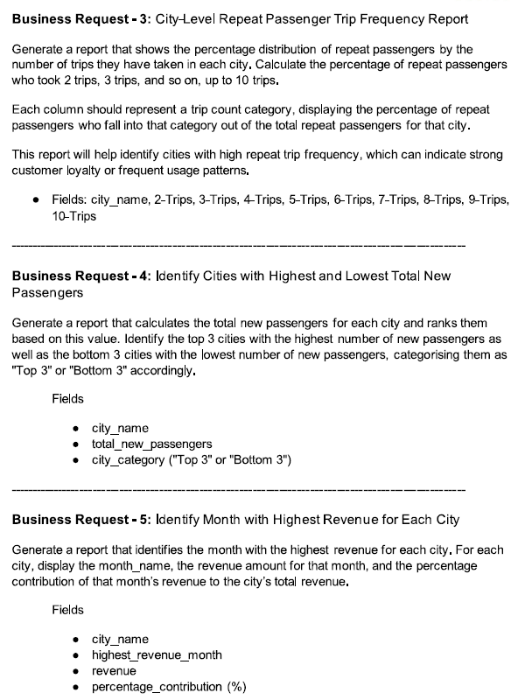
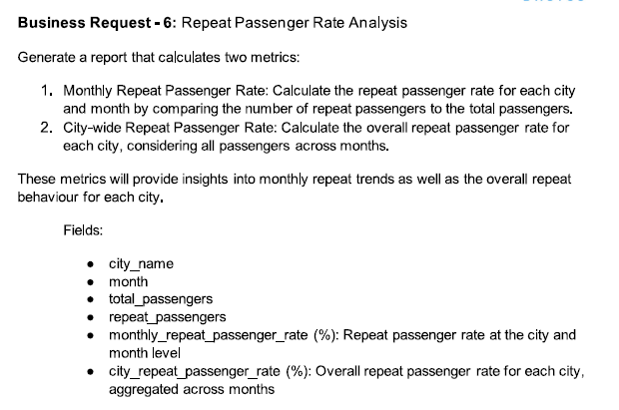
Ad-hoc (necessary / for this situation ) questions sent by Bruce
Alright, Bruce.
I’ll get you those insights!

Slide 8
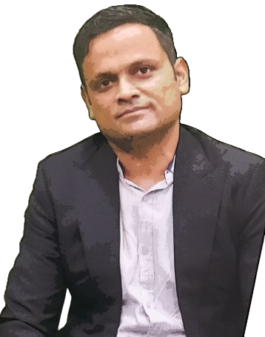
Hey Peter ,How are u doing ?
Did u answer ad-hoc questions sent to u?
Hlo Bruce , I am doing good.
I have completed SQL analysis of the questions you provided.
I’m ready to go through each of the insights and discuss any additional context you might need.
That’s great to hear,
Let’s start with the City level Fare and Trips Summary report
Sure Bruce !

Slide 9
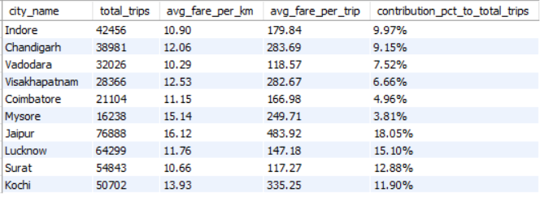
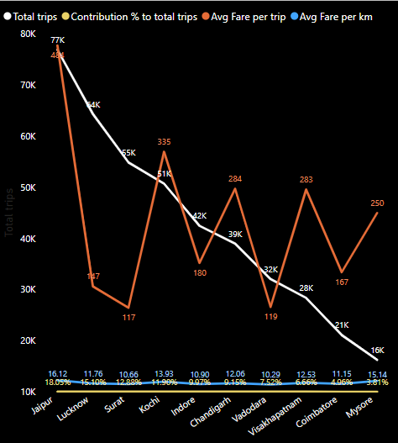
Question 1
Generate a report that displays the total trips, average fare per km, average fare per trip, and the percentage contribution of each city's trips to the overall trips. This report will help in assessing trip volume, pricing efficiency, and each city’s contribution to the overall trip count
Jaipur , Lucknow ,Surat,Kochi are best performing cities in terms of contribution % and Total Trips but Jaipur ,Kochi , Chandigarh , Vishakapatnam ,Mysore have high average fare per trip

Slide 10
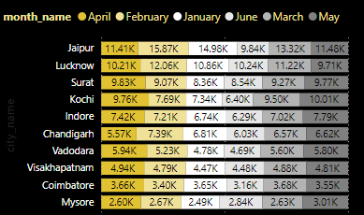
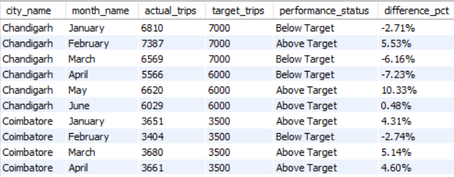
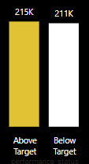
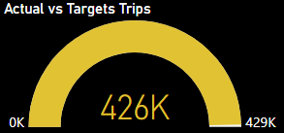
Question 2
Generate a report that evaluates the target performance for trips at the monthly and city level. For each city and month, compare the actual total trips with the target trips and categorize the performance as follows:
If actual trips are greater than target trips, mark it as 'Above Target'.
If actual trips are less than or equal to target trips, mark it as 'Below Target'.
Additionally, calculate the % difference between actual and target trips to quantify the performance gap.
Rows Continues
Out of 426K Actual Trips 215K Trips are above targeted trips

Slide 11
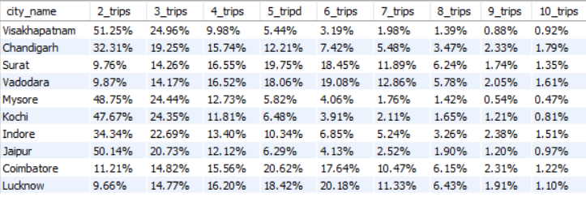
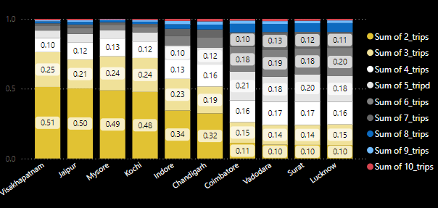
Question 3
Generate a report that shows the percentage distribution of repeat passengers by the number of trips they have taken in each city. Calculate the percentage of repeat passengers who took 2 trips, 3 trips, and so on, up to 10 trips.
Each column should represent a trip count category, displaying the percentage of repeat passengers who fall into that category out of the total repeat passengers for that city.
This report will help identify cities with high repeat trip frequency, which can indicate strong customer loyalty or frequent usage patterns.
In Vishakapatnam , Jaipur , Mysore and Kochi
50% of the passengers comes under 2 Trips.
Coimbatore , Vadodara ,Surat ,Lucknow have good Customer/Passenger loyalty because these cities have more trips under 4 trips,5 trips ,6 trips.

Slide 12
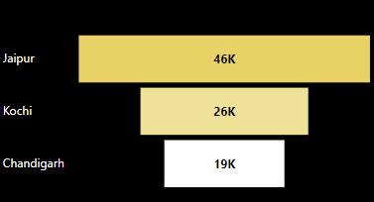
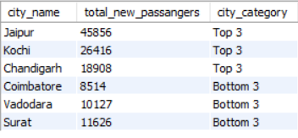
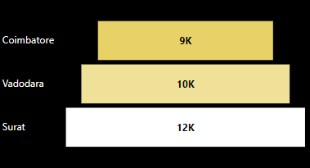
Question 4
Generate a report that calculates the total new passengers for each city and ranks them based on this value. Identify the top 3 cities with the highest number of new passengers as well as the bottom 3 cities with the lowest number of new passengers, categorizing them as 'Top 3' or 'Bottom 3' accordingly.
Top 3 Cities
Bottom 3 Cities
Jaipur has very high new passengers count ,
Coimbatore has lowest new passengers count.

Slide 13
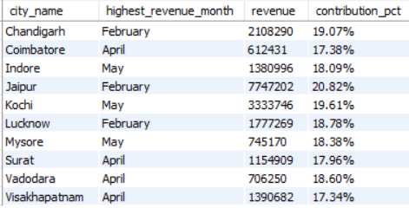
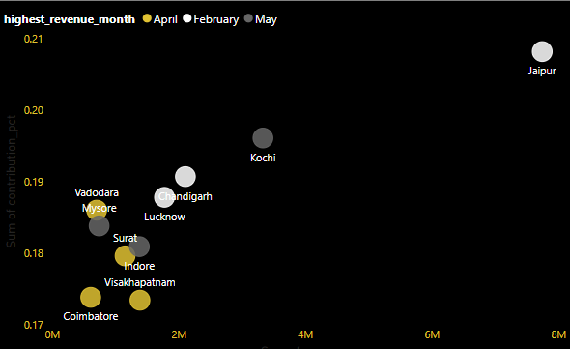
Question 5
Generate a report that identifies the month with the highest revenue for each city. For each city, display the month_name, the revenue amount for that month, and the percentage contribution of that month’s revenue to the city’s total revenue.
Jaipur in Feb,Kochi in May , Chandigarh in Feb generated Huge revenue with Highest contribution %.

Slide 14
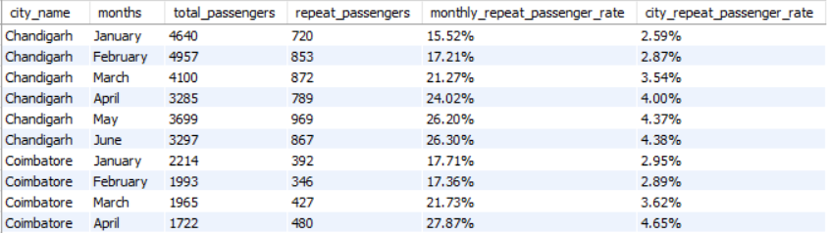
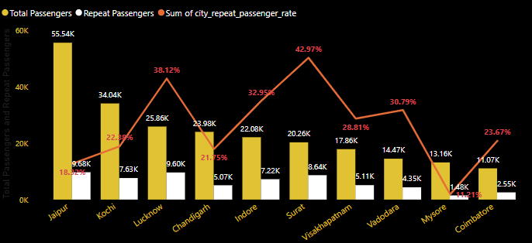
Question 6
"Generate a report that calculates two metrics:
Monthly Repeat Passenger Rate: Calculate the repeat passenger rate for each city and month by comparing the number of repeat passengers to the total passengers.
City-wide Repeat Passenger Rate: Calculate the overall repeat passenger rate for each city, considering all passengers across months.
These metrics will provide insights into monthly repeat trends as well as the overall repeat behavior for each city.
Rows Continues
Lucknow , Indore,Surat ,Vadodara has High passenger repeat %.
Jaipur , Mysore has very less passenger repeat %.

Slide 15
That’s great Peter , you did a good work in short time .
Thank you Bruce , Its because I prioritize work over other things
That’s good peter , When I can expect insights for my primary and secondary analysis questions.
I will provide it within 2 days Bruce , I hope its fine
Sure Peter , I will be waiting for your mail

Slide 16
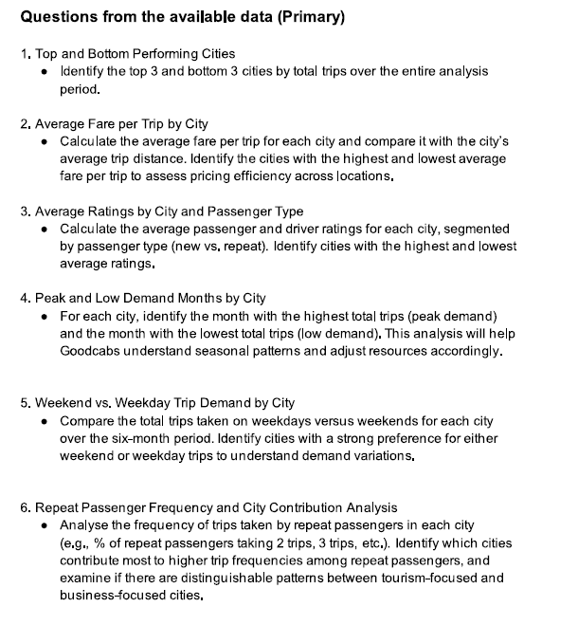
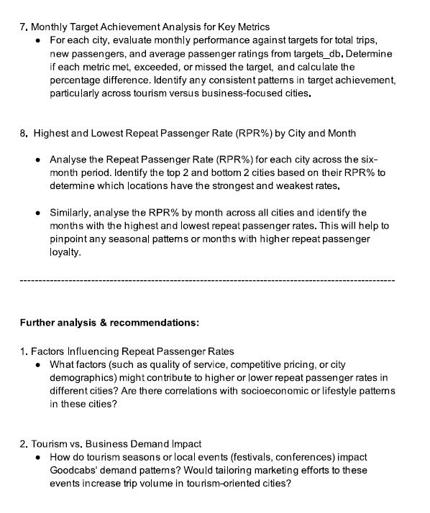
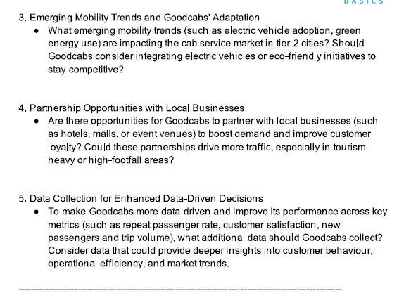
Primary and secondary analysis questions sent by Bruce
Intresting……

Slide 17
Two days later

Slide 18
Hello Bruce , I have gathered insights for all your primary and secondary analysis questions
Great Peter , you made it in time ! I appreciate that
Thank you Bruce , Shall we get into insights?
Sure Peter , I was waiting for that.

Slide 19
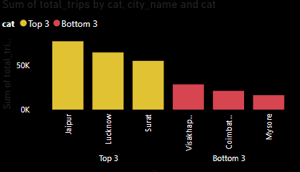
Question 1
Identify the top 3 and bottom 3 cities by total trips over the entire analysis period.
Jaipur , Lucknow , Surat are top 3 cities and Vishakapatnam , Coimbatore , Mysore are bottom 3 in terms of total trips

Slide 20
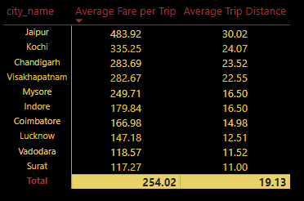
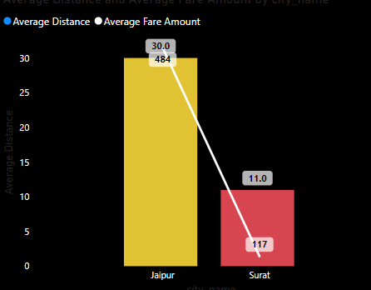
Question 2
Calculate the average fare per trip for each city and compare it with the city’s average trip distance. Identify the cities with the highest and lowest average fare per trip to assess pricing efficiency across locations.
Jaipur has highest fare per trip (484 INR) and Surat has lowest fare per trip (117 INR)

Slide 21
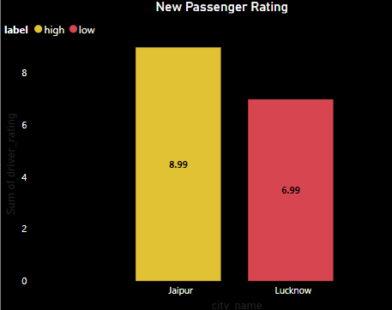
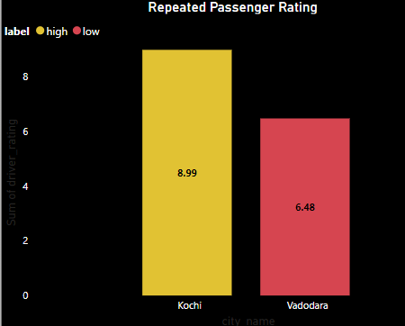
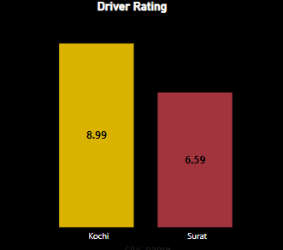
Question 3
Calculate the average passenger and driver ratings for each city, segmented by passenger type (new vs. repeat). Identify cities with the highest and lowest average ratings.
New Passenger rating : Jaipur Highest and Lucknow Lowest Repeated Passenger rating : Kochi Highest and Vadodara Lowest
Driver rating : Kochi Highest and Surat Lowest

Slide 22
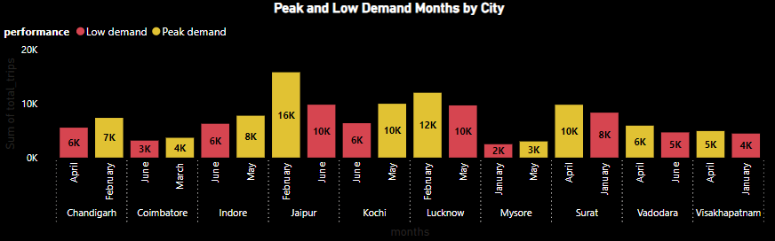
Question 4
For each city, identify the month with the highest total trips (peak demand) and the month with the lowest total trips (low demand). This analysis will help Goodcabs understand seasonal patterns and adjust resources accordingly.
Most of the cities have peak demand in month of February ,May or April

Slide 23
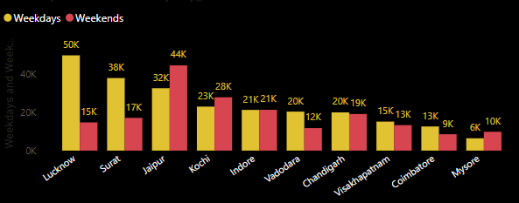
Question 5
Compare the total trips taken on weekdays versus weekends for each city over the six-month period. Identify cities with a strong preference for either weekend or weekday trips to understand demand variations.
Weekday Preference : Lucknow ,Surat ,Vadodara , Chandigarh,Vishakapatnam ,Coimbatore Weekend Preference : Jaipur ,Kochi ,Mysore

Slide 24
Question 6
Analyze the frequency of trips taken by repeat passengers in each city (e.g., % of repeat passengers taking 2 trips, 3 trips, etc.). Identify which cities contribute most to higher trip frequencies among repeat passengers, and examine if there are distinguishable patterns between tourism-focused and business-focused cities.
Surat , Lucknow ,Coimbatore ,Vadodara contribute more to Higher trip frequencies ,these are business focused cities Jaipur , Mysore ,Vishakapatnam ,Kochi are Tourism focused cities and they have highest(50%) of two trips
Surat , Lucknow ,Coimbatore ,Vadodara contribute more to Higher trip frequencies ,these are business focused cities Jaipur , Mysore ,Vishakapatnam ,Kochi are Tourism focused cities and they have highest(50%) of two trips percentage.

Slide 25
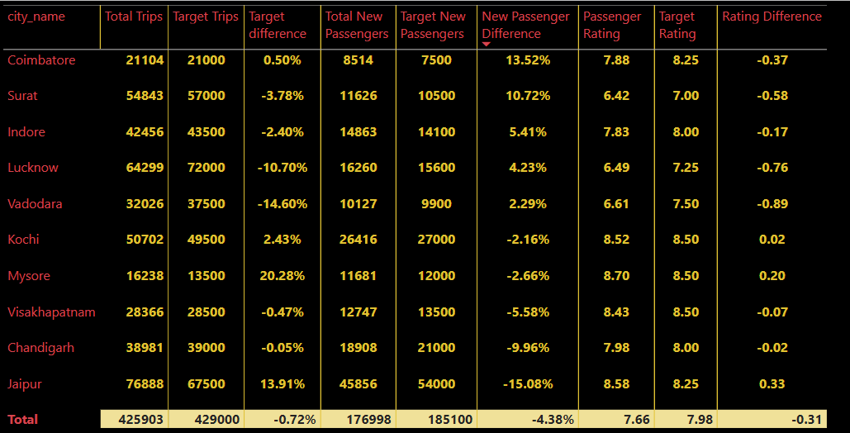
Question 7
For each city, evaluate monthly performance against targets for total trips, new passengers, and average passenger ratings from targets_db. Determine if each metric met, exceeded, or missed the target, and calculate the percentage difference. Identify any consistent patterns in target achievement, particularly across tourism versus business-focused cities.
Tourism cities like Jaipur , Mysore ,Kochi has reached more than target trips and more than Target rating

Slide 26
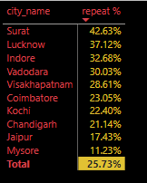
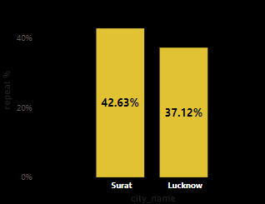
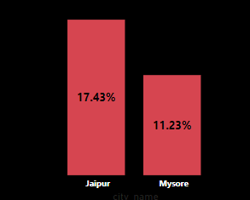
Question 8 A
Analyze the Repeat Passenger Rate (RPR%) for each city across the six-month period. Identify the top 2 and bottom 2 cities based on their RPR% to determine which locations have the strongest and weakest rates.
Surat and Lucknow have Highest RPR% and Jaipur ,Mysore have lowest RPR%

Slide 27
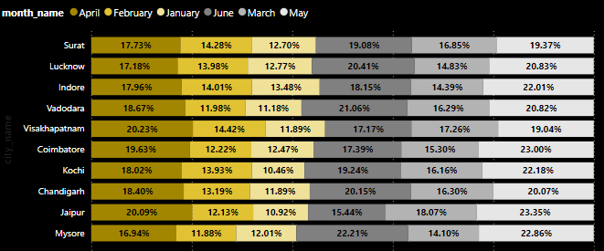
Question 8
B
Similarly, analyze the RPR% by month across all cities and identify the months with the highest and lowest repeat passenger rates. This will help to pinpoint any seasonal patterns or months with higher repeat passenger loyalty.
All cities except Vishakapatnam has highest RPR% in May Vishakapatnam has highest RPR% in April Except Mysore ,Coimbatore all other cities have lowest RPR% in January , Mysore , Coimbatore have lowest RPR% in February

Slide 28
Fantastic Peter , these insights are very important to me
Its my duty Bruce
Peter , I want you to create a interactive dashboard about the performance , metrices , revenue of Goodcabs
Sure Bruce , I will start the work today itself, you will get interactive and insightful dashboard within 2 days
Okay Peter

Slide 29
Two days later

Slide 30
Bruce I have the completed the Dashboard , I will provide you the dashboard link and presented vedio link. You can mail me if u need any improvements
Sure Bruce , I will inform you if I need any improvements
Here you go Bruce Dashboard link : GoodCabs live Dashbaoard Youtube Presentation vedio : Presentation Vedio

Slide 31
Dashboard images

Slide 32
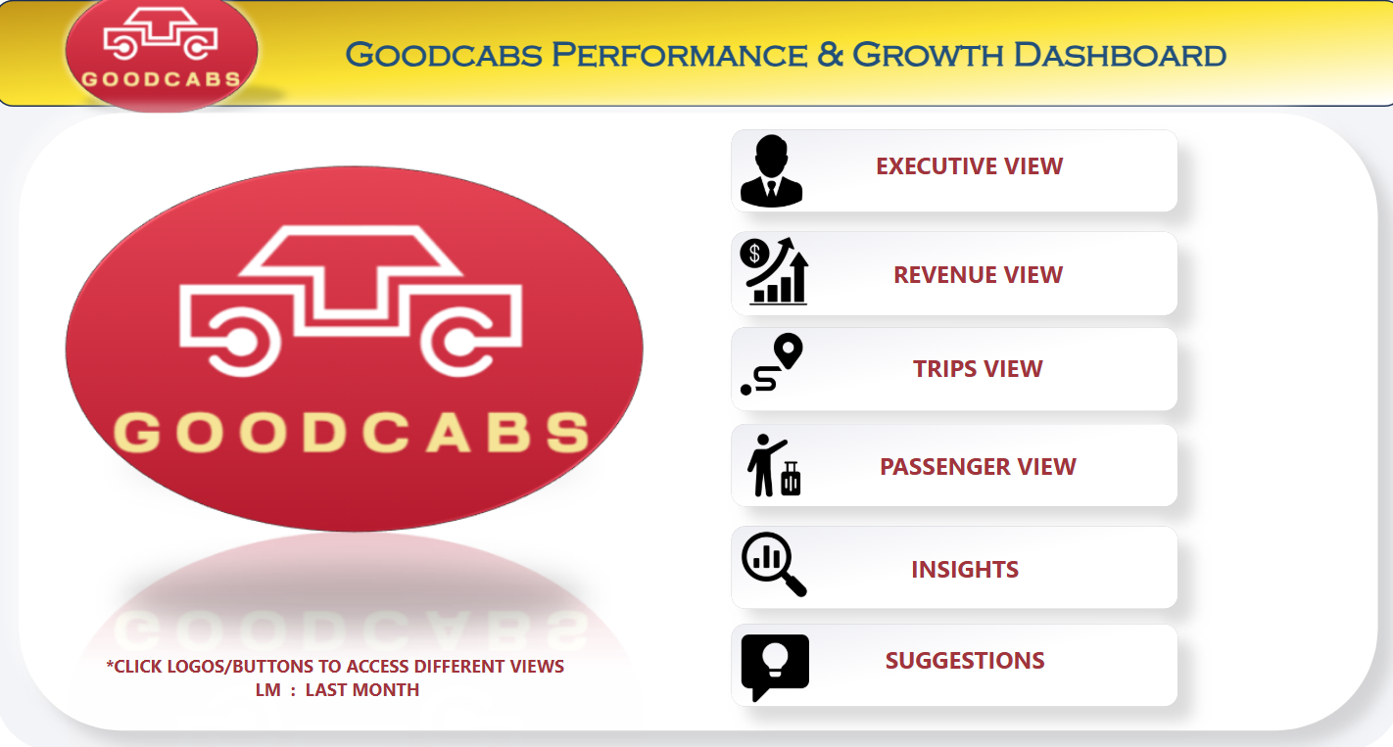

Slide 33
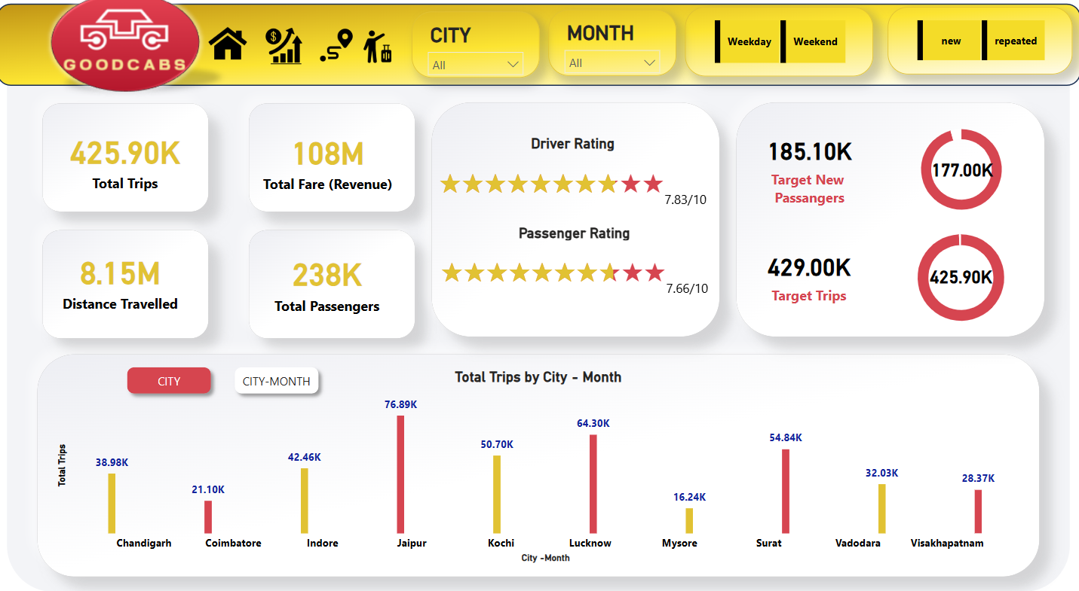

Slide 34
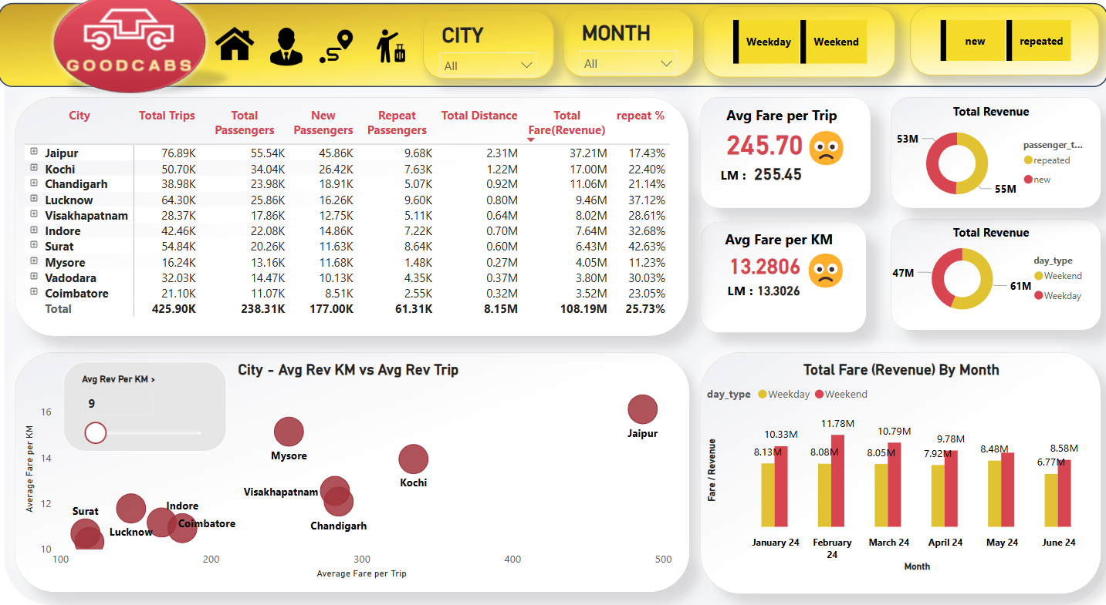

Slide 35
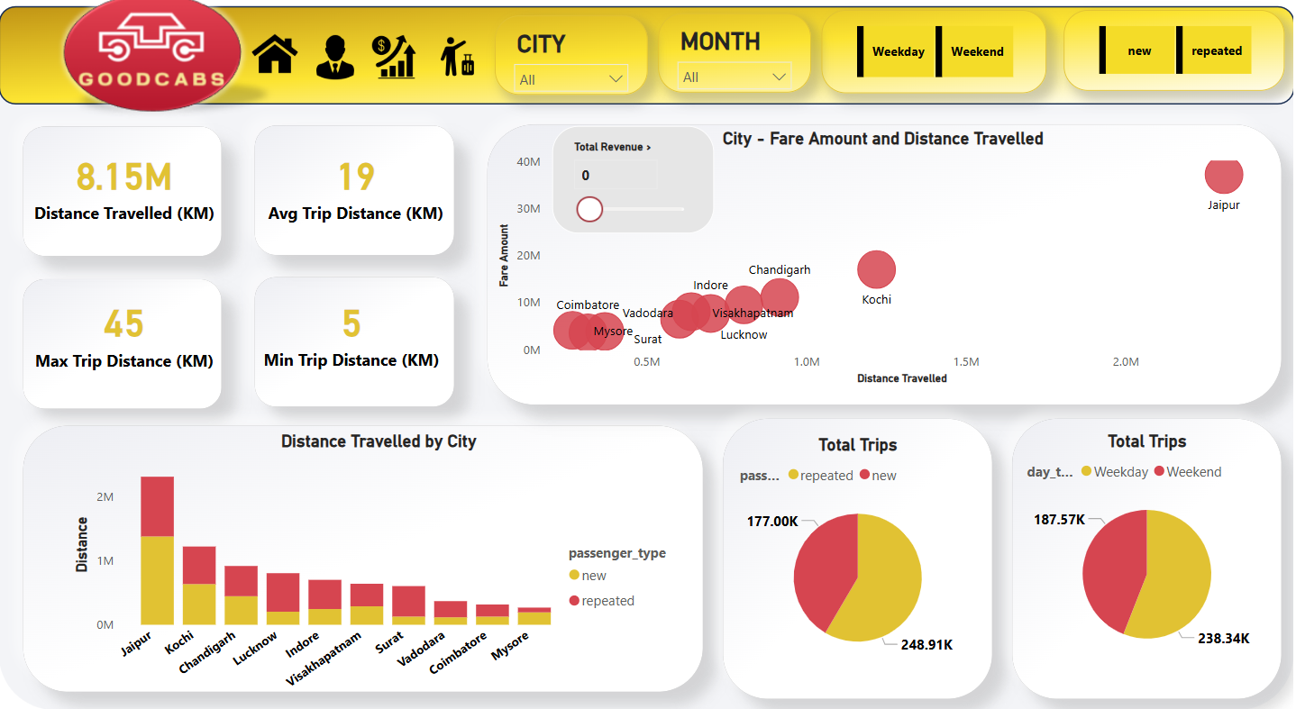

Slide 36
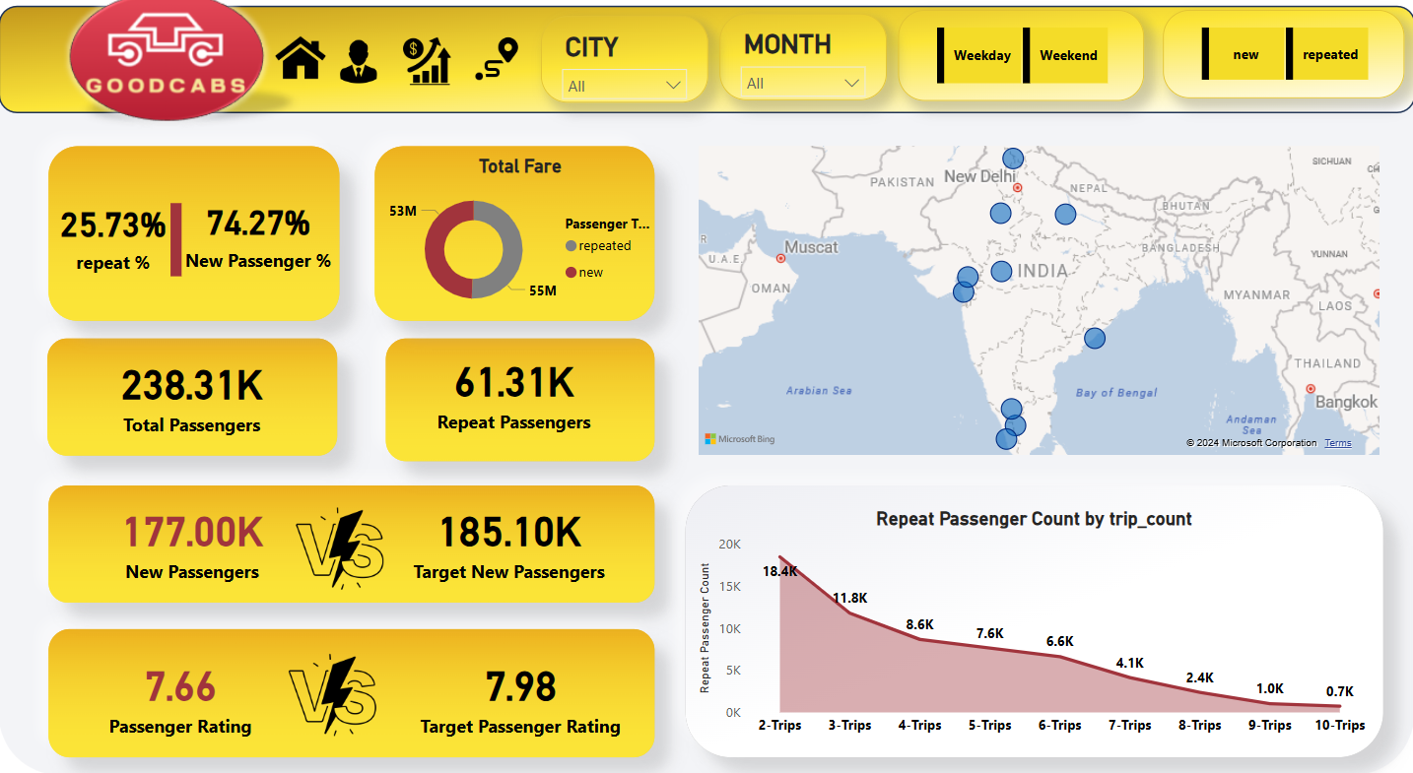

Slide 37
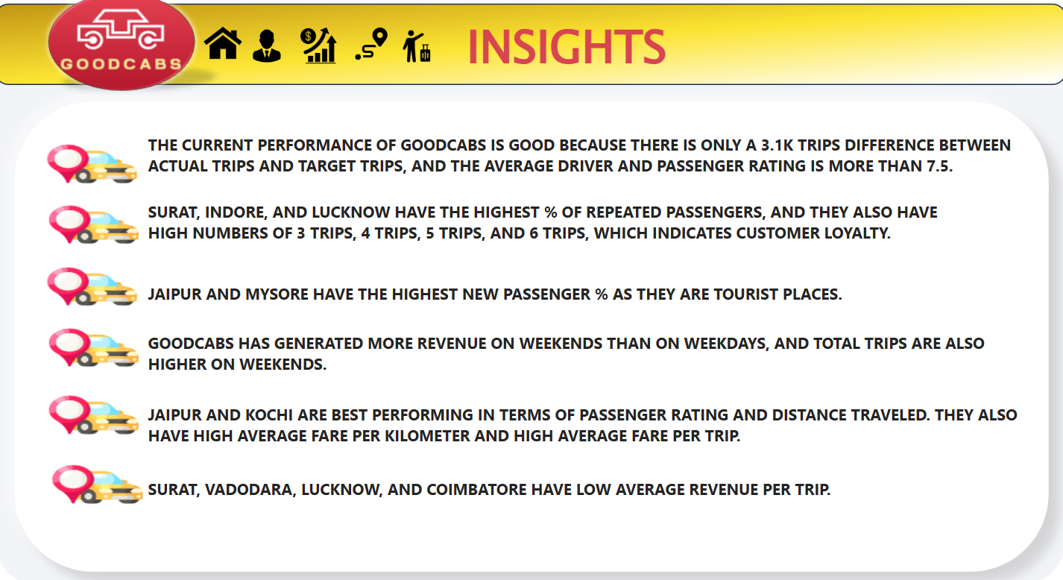

Slide 38
